Slide 1

The impact of data preprocessing on the quality of tree-based models with forester package.
Author: Hubert Ruczyński,
Supervision: Anna Kozak, Anna Cena
Warsaw University of Technology
Notes:
Hi, during the previous presentation, which occurred at the beginning of the semester I had an opportunity to introduce you to the forester project, including plenty of insights, which actually made it difficult to prepare todays talk. As I don’t want to tell you the same things twice, today I won’t talk about the implementation tasks, and focus much more on the study I want to conduct

Slide 2
Thesis goals
1. The purpose of this work is to investigate the impact of data preprocessing on the quality of modeling using tree-based models in binary and multiclass classifications and regression tasks.
2. The indirect result of the work will be the implementation of selected techniques in the form of an extension to the R language package called forester.
Notes:
First of all, let’s remind the main goals of my Master’s Thesis.
As mentioned in its title: The purpose of this work is to investigate the impact of data preprocessing on the quality of modeling using tree-based models in binary and multiclass classifications and regression tasks.
Additionally, the indirect result of the work will be the implementation of selected techniques in the form of an extension to the R language package called forester.
Pretty straightforward, isn’t it? Regardless of the answer, the journey towards the thesis topic was quite long, and that’s why I’ll speak more about the background for that work.

Slide 3
Thesis Landscape
Data Preprocessing Studies
Automatic
Data
Preprocessing
Approaches to
AutoML
AutoML
Solutions
In R
Notes:
In order to do that I’m going to paint you the landscapes of four areas that are crucial for this study.
The first one regards the data preprocessing studies in general,
whereas the second is more practical as it focuses on an automatic data preprocessing attempts.
The last two on the other hand are related to different AutoML approaches,
and AutoML solutions in R.

Slide 4
Thesis Landscape
Data Preprocessing Studies
Automatic
Data
Preprocessing
Analyzing the Impact of Data Preprocessing Strategies on tree-based models with forester
Approaches to
AutoML
AutoML
Solutions
In R
Notes:
Finally, when we combine all of them we will be able to comprehend the topic of my thesis. So, let’s start with the overview of data preprocessing studies.

Slide 5
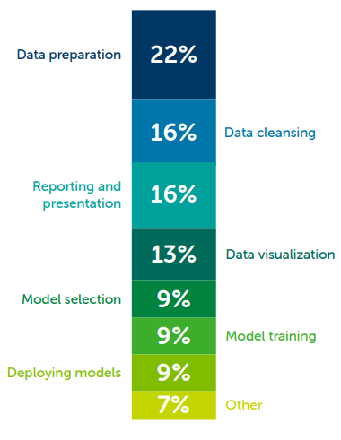
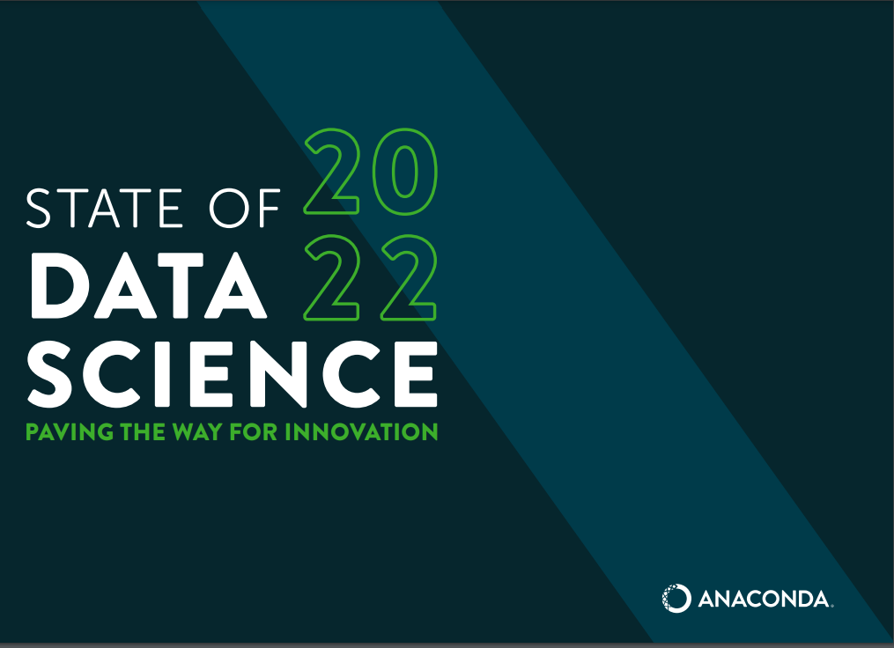
Anaconda DS study
Notes:
As data scientists we cannot neglect the impact of the data preparation stage on the outcomes returned by the machine learning solutions. The importance of this part of the ML pipeline is undisputed, it even finds its way into spoken language, as a saying ’garbage in, garbage out’ (GIGO), describing that inferior quality input always results in poor output. The reflection of those beliefs is clearly visible in Anaconda’s report.
The study backs up the common knowledge that ML specialists spend the least time on tasks related to modeling (27%), they focus more on the plotting and presentation of results (29%), and data preparation and cleaning (38%). It proves, that this part of the machine learning pipeline is of utmost importance.
However, the sole knowledge that in general, we should preprocess the data before the modeling phase is not enough as it does not describe how we can do this. The literature offers an abundance of approaches for data preparation, varying for different tasks, used models, or even particular datasets, which overwhelms not only newcomers but also experienced ML engineers. Thankfully, the scientific community tries to find a solution for such issues by conducting multiple studies regarding the optimal choice of preprocessing strategies for various settings.

Slide 6
Data Preprocessing Studies
1. [Isik et al., 2012] – Data preprocessing for ANNs (Artificial Neural Networks)
2. [Shopov and Markova, 2013] – Data preprocessing for time series predictions
3. [Symeonidis et al., 2018] – Data preprocessing for NLP (Natural Language Processing)
Notes:
An example of such study, regards the importance of data preprocessing for neural architectures [Isik et al., 2012]. It is an extremely interesting case, as it dates back to 2012 when the data science community witnessed a sudden growth of interest regarding artificial neural networks (ANNs), which immediately resulted in a model-specific data preparation study. In their work, the authors underline that the performance of ANNs is highly dependent on the data quality, and used preprocessing methods.
Another group of preprocessing strategies studies regards specific ML tasks, such as time series predictions [Shopov and Markova, 2013]. This paper focuses on a different task, where the major issues are connected to missing data and the presence of unwanted outliers. The results prove, that when the number of missing values or outliers is higher than 10%, the forecasts achieved on raw results yield large errors, whereas after applying data preprocessing strategies, we are still able to obtain reasonable results.
Similar study, has been conducted in order to evaluate multiple commonly used preprocessing strategies for semantic analysis task [Symeonidis et al., 2018]. The authors experimentally compared 15 different approaches on two Twitter datasets, and applied three machine learning algorithms in order to cover a wide range of methods. For example, the results indicate that the removal of numbers, stemming, and replacing the repetitions of punctuation positively impact the performance in all cases, whereas the removal of punctuation, lower-casing the text, or replacing slang and abbreviations worsen the models’ performance.
The aforementioned papers, underline the importance of data preprocessing, regardless of the machine learning sub-domain, and point out the need for case-specific studies. The presented papers provide extremely valuable results, even though the questions regarding some areas, such as tree-based models, remain unanswered, which generates an opportunity for my own study.

Slide 7
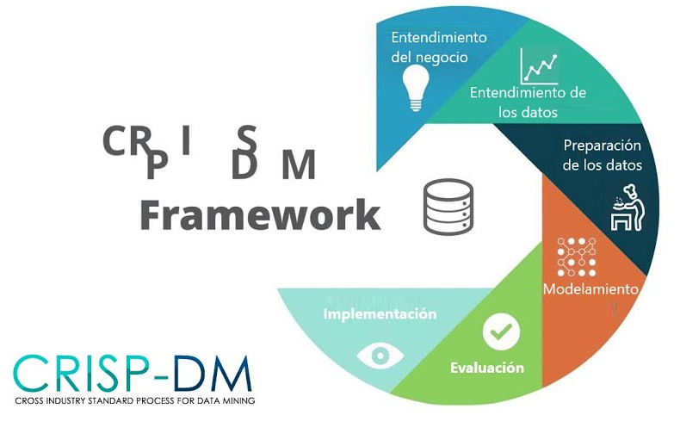
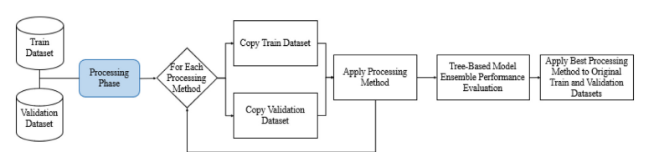
Automatic Data Preprocessing
Atlantic
Notes:
We would expect that AutoML, whose objective is not limited to producing models only, would prepare solutions for automated data preparation. There
are examples like the CRoss Industry Standard Process for Data Mining (CRISP-DM) [Wirth and Hipp, 2000] being the most common methodology for data mining, analytics, and data science projects. However, the basic framework of this machine learning system is focused entirely on the preparation of models based on data entered by the user, even though they incorporate automatic data preparation techniques inside their pipelines.
There are only a few solutions such as the Atlantic [Santos and Ferreira, 2023] package in Python that attempt to automate this part of the machine learning pipeline and expose those features to the users in an approachable way. This tool integrates multiple customizable preprocessing mechanisms, including date-time feature engineering, automated feature selection, categorical encoding techniques, and null imputation methods. Even though the main goal of Atlantic is to automatically identify the best combination of preprocessing mechanisms for a specific dataset, it lacks a thorough evaluation of whether their solutions actually improve models’ performance. Luckily, it presents a great opportunity for such studies, thanks to the well-designed user interface.

Slide 8



AutoML Approaches
Notes:
To better understand the uniqueness of the forester data-centered approach, we should analyze current SOTA approaches to AutoML solutions.
One of the most commonly used packages is Auto-sklearn 2.0 [Feurer et al., 2022], which is a newer, and improved version of Auto-sklearn [Feurer et al., 2015]. The reason for introducing a novel, meta-learning-based approach was a result of winning the second ChaLearn AutoML challenge, where the authors modified the AutoML pipeline by adding a Portfolio Successive Halving (PoSH) as a budget allocation strategy. This strategy enabled them to achieve better results in a six times shorter training period, in comparison to Auto-sklearn 1.0. The meta-learning approach was compared to other frameworks, such as Auto-WEKA, TPOT, and H2O, and proved to be the best-performing one for half of those tasks.

Slide 9


AutoML Approaches
Notes:
A fundamentally different approach is proposed in the case of FLAML, which does not want to rely on the expensive preparation stage of meta-learning approaches, and avoids the necessity of any computational overhead. The main goal of this tool is to leverage the structure of the search space to choose a search order optimized in terms of cost, and performance. The authors introduce a metric called estimated cost of improvement (ECI), which is used for defining the optimization problem regarding, the final cost measure. In order to achieve satisfactory results, before training the model, FLAML estimates the ECI, and if it is too high, it avoids such a solution and tries the less expensive ones. This way, the tool is encouraged to test the least expensive strategies in early iterations, and gets to the more expensive ones later, where simple models are penalized. Such an approach lets the library ensure strong anytime performance, regardless of the complexity of the task.

Slide 10



AutoML Approaches
Notes:
Another popular AutoML solution for Python is called AutoGluon [Erickson et al., 2020]. It is a framework developed by Amazon that requires only a single line of code to train highly accurate models on an unprocessed tabular dataset such as a CSV file. Its performance is most impressive, as the package often outperforms the best results achieved by human competitors in Kaggle competitions. On the contrary to existing AutoML solutions that primarily focus on hyperparameter selection, AutoGluon succeeds by ensembling multiple models and stacking them in multiple layers. Presented experiments show that a multi-layer combination of many models offers better use of allocated training time than seeking out the best configuration.

Slide 11
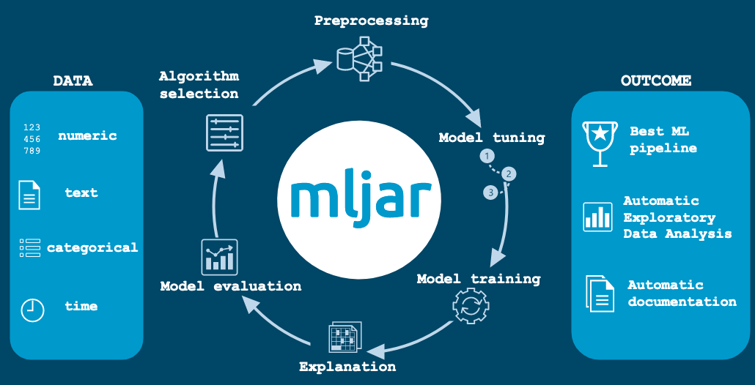
AutoML Approaches
Notes:
Another interesting approach is the business-oriented package called mljar-supervised, developed by a Polish couple Mr. Płoński, and Mrs. Płońska, which I met during the ML in PL conference. It is an open source solution, which distinguishes itself by proposing various objectives for the models training. The selectable modes include the ones focused on explaining the dataset and trained models, the competitive mode with advanced training methods, or the performance-oriented mode, which lets us easily deploy the final outcomes locally or in the cloud. Additionally, the users can choose from a wide range of optimization functions, including the fairness metrics, ensuring that the obtained solutions are not biased towards any class.

Slide 12
AutoML Approaches
Meta-Learning – Auto-Sklearn, Auto-Sklearn 2.0
Lightweight AutoML – FLAML with ECI
Hyperparameter Selection with Stacking – AutoGluon
User-Centered – Mljar-supervised
Data-centered – forester
Notes:
Presented solutions aimed at showing that, although the AutoML frameworks theoretically do the same thing, the means to achieve those results are different.
In particular we can outline that Auto-Sklearn utilizes meta-learning
FLAML introduces ECI – estimated cost of improvement Metric, to ensure lightweight solution,
AutoGluon incorporates hyperparameter selection methods, based on model stacking,
Whereas Mljar-supervised focuses mainly on the user needs and experience.
Following the pattern, we want to add a fifth, data-centered approach for the forester package.

Slide 13


AutoML in R
Notes:
To finalize the landscape of my study, let’s get into the AutoML solutions in R. Unfortunately, all of the aforementioned tools are implemented in Python, and in general it is hard to find the frameworks written in R. Specifically, there are very few fresh ideas there, and two most known solutions are: mlr3 and H2O AutoMLs.
The first one is based on a well-established tool for building ML pipelines, slightly similar to sklearn. The package provides a comprehensive framework for classification, regression, survival analysis, and other machine learning tasks, including cluster analysis, however its main drawback is the fact that it is not an end-to-end solution, and it requires lots of ML experience to use it.
The H2O AutoML’s origins are quite interesting, as this tool, similarly to whole AutoML concept originates from Java. The framework is written in java, and provides interfaces for R, Python and a few other languages. It is important, as it means that while executing this code you need to have proper Java version installed, and the R executes the Java process, which generates lots of issues, such as inability to stop the code execution, crashing the Java environment, and so on. On the other hand this package lets the user conduct an end-to-end ML process, including the preparation of training reports, and model explanations, although it still requires the previously preprocessed datasets. The detailed comparison is presented in my Bachelor Thesis.

Slide 14
Preliminary results
Notes:
As shown in the previous presentation, I’ve already set the main goals of the study, its experiments, and achieved some results, which I’d like to share during the second half of this talk.

Slide 15
Goals recap
1. The main goal of the study is to evaluate how different preprocessing strategies contribute to the performance of tree-based models for binary classification, regression, and multicalss classification tasks.
2. The means to achieve that is further development and incorporation of the forester AutoML package.
Notes:
As a quick recap: The main goal of the study is to evaluate how different preprocessing strategies contribute to the performance of tree-based models for binary classification, regression, and multicalss classification tasks.
To achieve that, we modify, and incorporate the forester package.

Slide 16
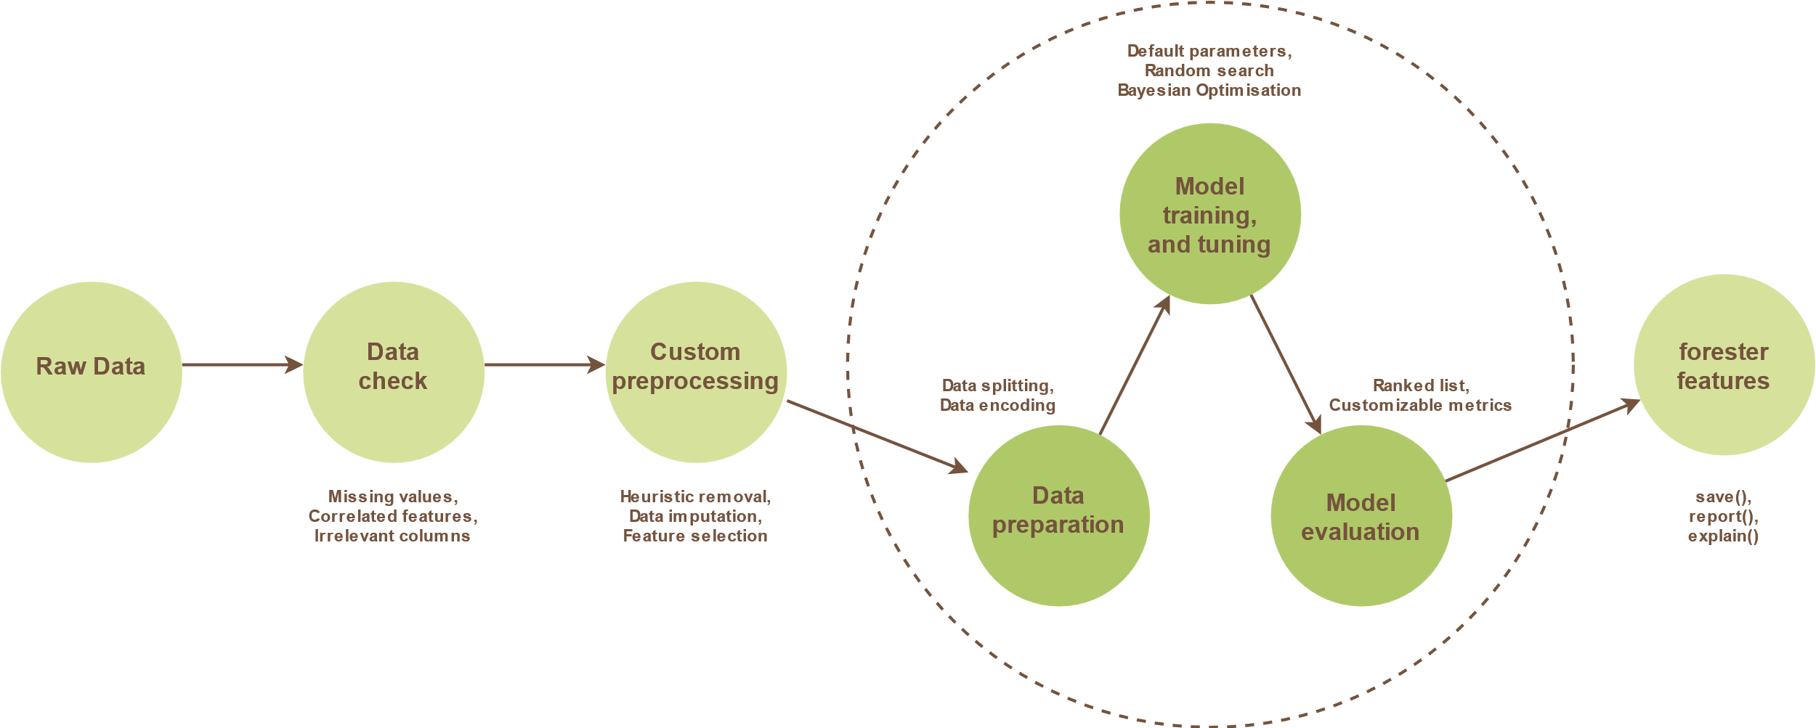
forester pipeline
Notes:
The main addition to this framework is an addition of Custom preprocessing module, which lets the users, quickly turn on, and off various preprocessing strategies, so they can be suited for particular tasks.
The custom preprocessing is divided into three areas, being heuristic removals, data imputation, and feature selection.

Slide 17
Custom preprocessing
1. Heuristic removals:
Duplicated columns,
Id-like columns,
Static columns,
Sparse columns,
Highly correlated,
Corrupted rows.
2. Data Imputation:
Median-other,
Median-frequency,
KNN,
MICE.
3. Feature Selection:
Mutual Information,
Boruta,
MCFS,
Variable Importance.
39 unique strategies in the study.
Notes:
The first one uses up to 6 separate criterion which determine whether a columns or row should be removed or not, being: Duplicated, Id-like, Static, Sparse, or Highly correlated columns, and Corrupted rows.
The second area focusing on data imputation, lets the user Choose one of four methods being: median-other, median-frequency, k nearest neighbours, or multivariate imputation by chain equations.
Whereas the last sub-module contains four feature selection methods, such as mutual infromation based method, boruta, monte carlo feature selection, and variable importance.
Based on the subset of those setting, we could create nearly 600 different preprocessing strategies for a single dataset, however most of them would provide fairly similar results, and the computations would be infiseable, thus we finally created 39 unique strategies which were used for all datasets in our study.

Slide 18
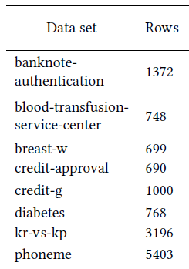
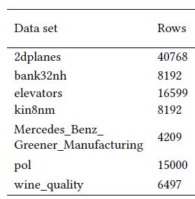
Experiments design
39
strategies
100
models
Notes:
Eventually, the experiments were conducted on 15 binary classification, and regression datasets of various characteristics. During the next semester we are planning to add a multiclass classification task, and thus the numer of datasets will definitely grow in size.
For each of them we used the aforementioned 39 preprocessing strategies
And finally, we trained 100 models for each of those datasets. There were 5 different engines: ranger, xgbosst, decision tree, lightgbm, and catboost, and for each of them we trained 20 random searched models. We decided to omit bayesian optimization, due to the computation limitations,

Slide 19
Time analysis
Notes:
So now, let’s get to the results. The first part will regard the time complexity.

Slide 20
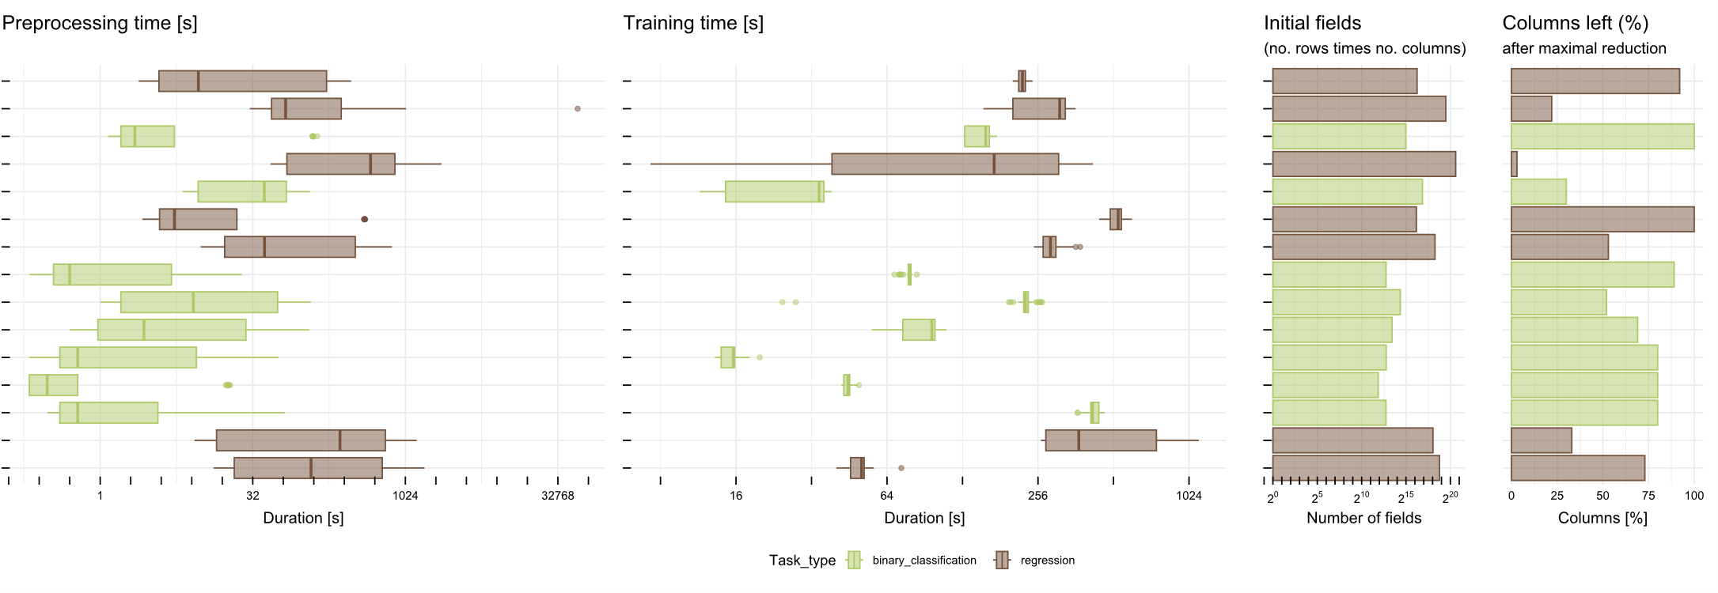
Separate times
Notes:
The first plot shows us that the preprocessing duration differs a lot for each dataset, however, the training times, are more similar to each other. Major training time differences happen only for the datasets that had the most columns removed during the preprocessing strategy that yielded the biggest dimensionality reduction. It indicates that vast dimensionality reduction leads to shorter training times.
Additionally, we can witness that the preprocessing times are much shorter for the binary classification tasks, due to the smaller number of initial fields.

Slide 21
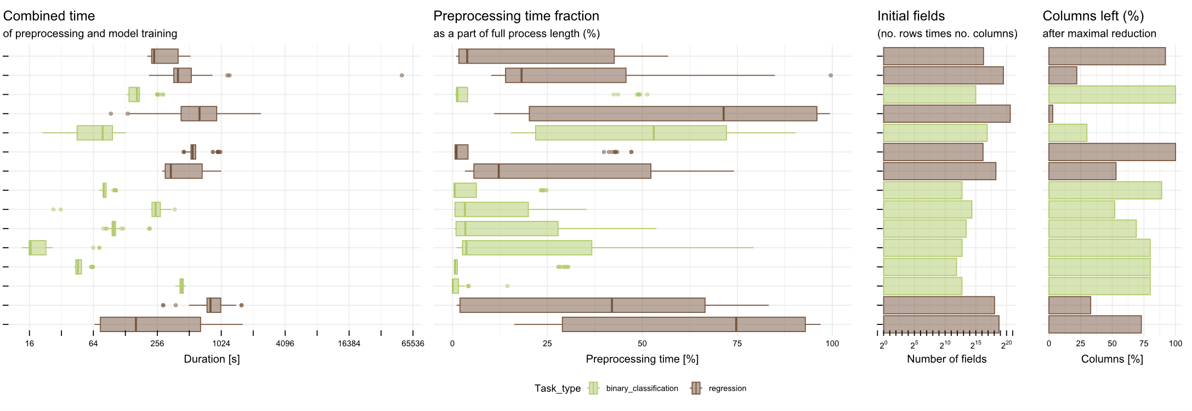
Combined times
Notes:
From the second figure, we can notice that the combined preprocessing and training time level off, and the final sum of them is less varying than the preprocessing time itself. It proves, that longer preprocessing with more data removal leads to shorter training times.
Additionally, the second subplot measuring the fraction of preprocessing time in the whole process shows us that in the case of smaller datasets without major feature removal, even extensive preprocessing strategies last much shorter than the training, whereas, for large tasks with stronger column removal, the data preparation can be much longer than the training.
Moreover, for most dataframes, these relative proportions differ a lot, which means that there are some extremely time-consuming preprocessing strategies, which might not be optimal and we should be careful while selecting those.

Slide 22
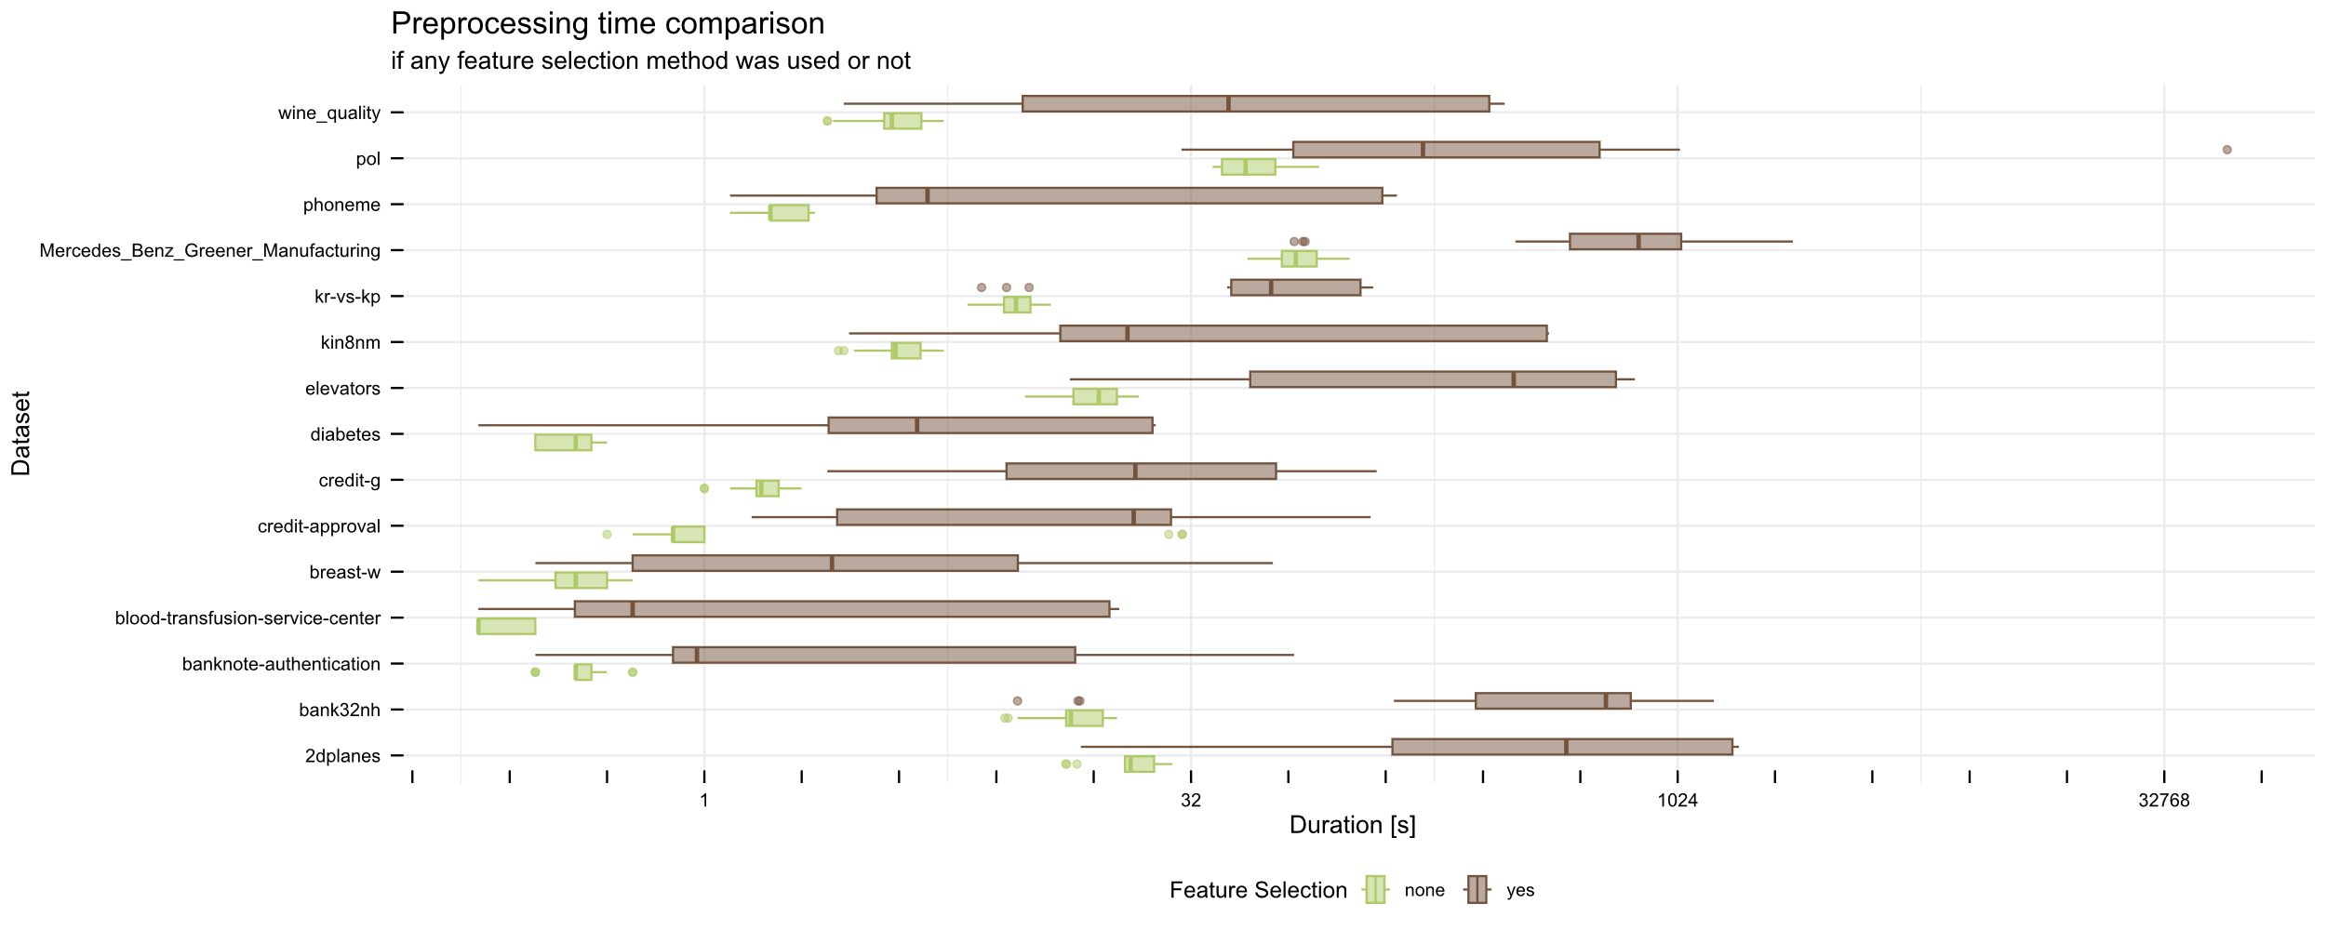
Preprocesing time depending on FS
Notes:
To follow up on the impact of the highly varying time complexity of different preprocessing strategies, we will delve deeply into different approaches and their durations. Based on those results we can evaluate which methods might be useful in real-life modeling, and which are too expensive.
In this figure, we are presented with the durations divided by the presence of any feature selection method. It shows us, that lack of these elements leads to much shorter, and less varying times.

Slide 23
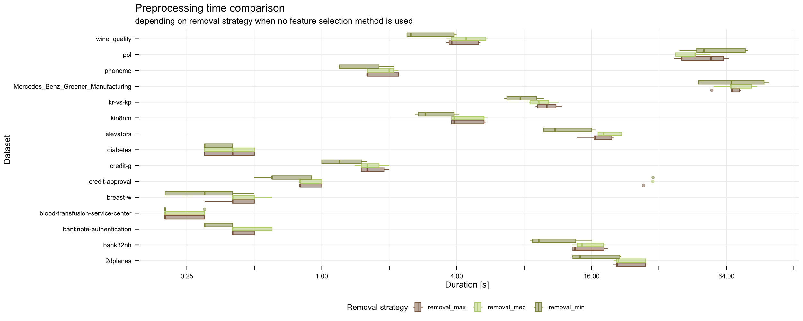
Preprocesing time for removals
Notes:
Additionally, according to the next plot we can witness that in the case of strategies not involving feature selection, there aren’t any major differences between different removal approaches. This facts combined made us take a closer look at feature selection strategies.

Slide 24
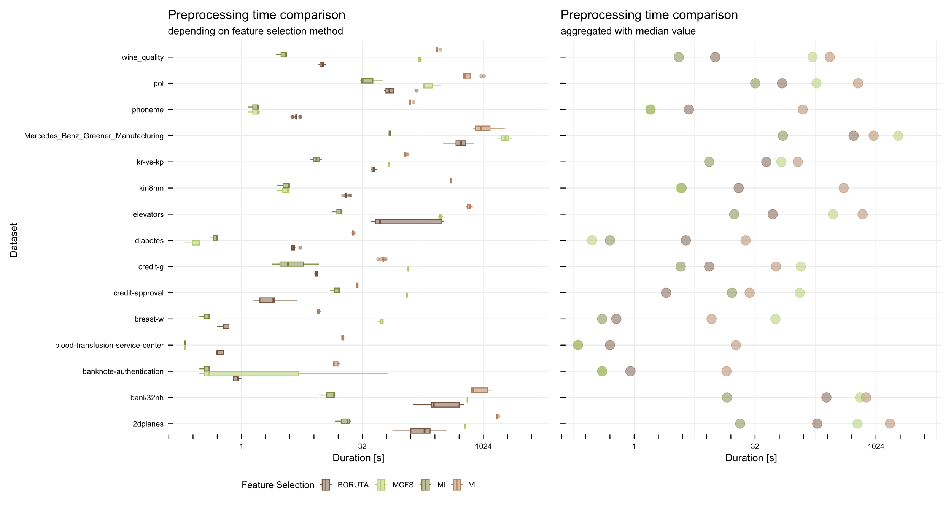
Comparison of FS times
Notes:
Firstly, we compared the preprocessing times, depending on the feature selection method. The left plot shows raw results, whereas the right one focuses on the median value, so the results can be more readable.
It is easily noticable, that there are two relatively fast methods, being: Boruta, and Mutual information, and two extremly slow ones: MCFS, and Variable Importance.

Slide 25
Preofrmance analysis
Notes:
Similarly to the time analysis, the first step for performance analysis is to determine whether there are any significant differences between all preprocessing strategies.

Slide 26
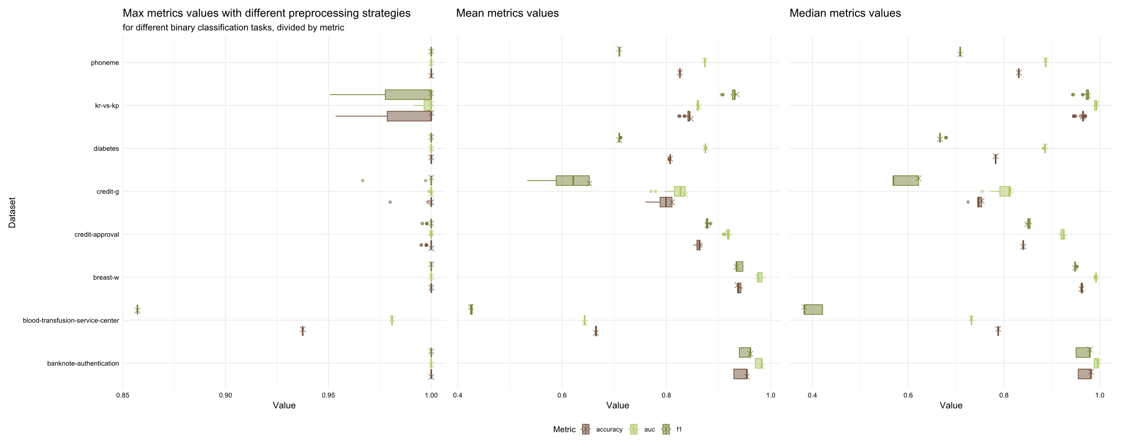
Advanced vs baseline - classification
Notes:
The first plot shows us that for small binary classification tasks, there were not many differences between maximal scores, however, they occurred for both mean and median aggregations.
From those two subplots, we can see that in the case of wide boxplots, the X-mark describing the baseline model with minimal preprocessing, in most cases landed on the right side of the box. It means, that in general, advanced preprocessing strategies lead to the worsening of the models’ performance.
This trend did not happen every time, as for breast-w dataset baseline results were worse than the ones with preprocessing, and for the credit-approval, they were in the middle. Additionally, we can notice that aggregations by mean and median are similar to each other, thus in further plots, we will use the mean aggregation only.

Slide 27
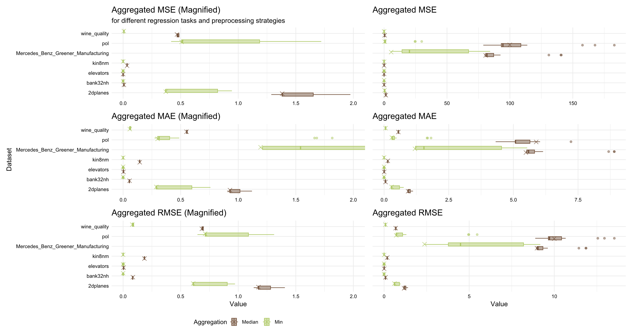
Advanced vs baseline - regression
Notes:
The latter plot suggests that for large regression tasks, the differences between various preprocessing strategies are even larger than for the smaller tasks, and tend to provide worse results than the baseline.
The only task that achieved slightly better results was described by the pol dataset, which was a highly dimensional problem. As all three metrics provide fairly similar results, we will use only RMSE in further visualizations.

Slide 28
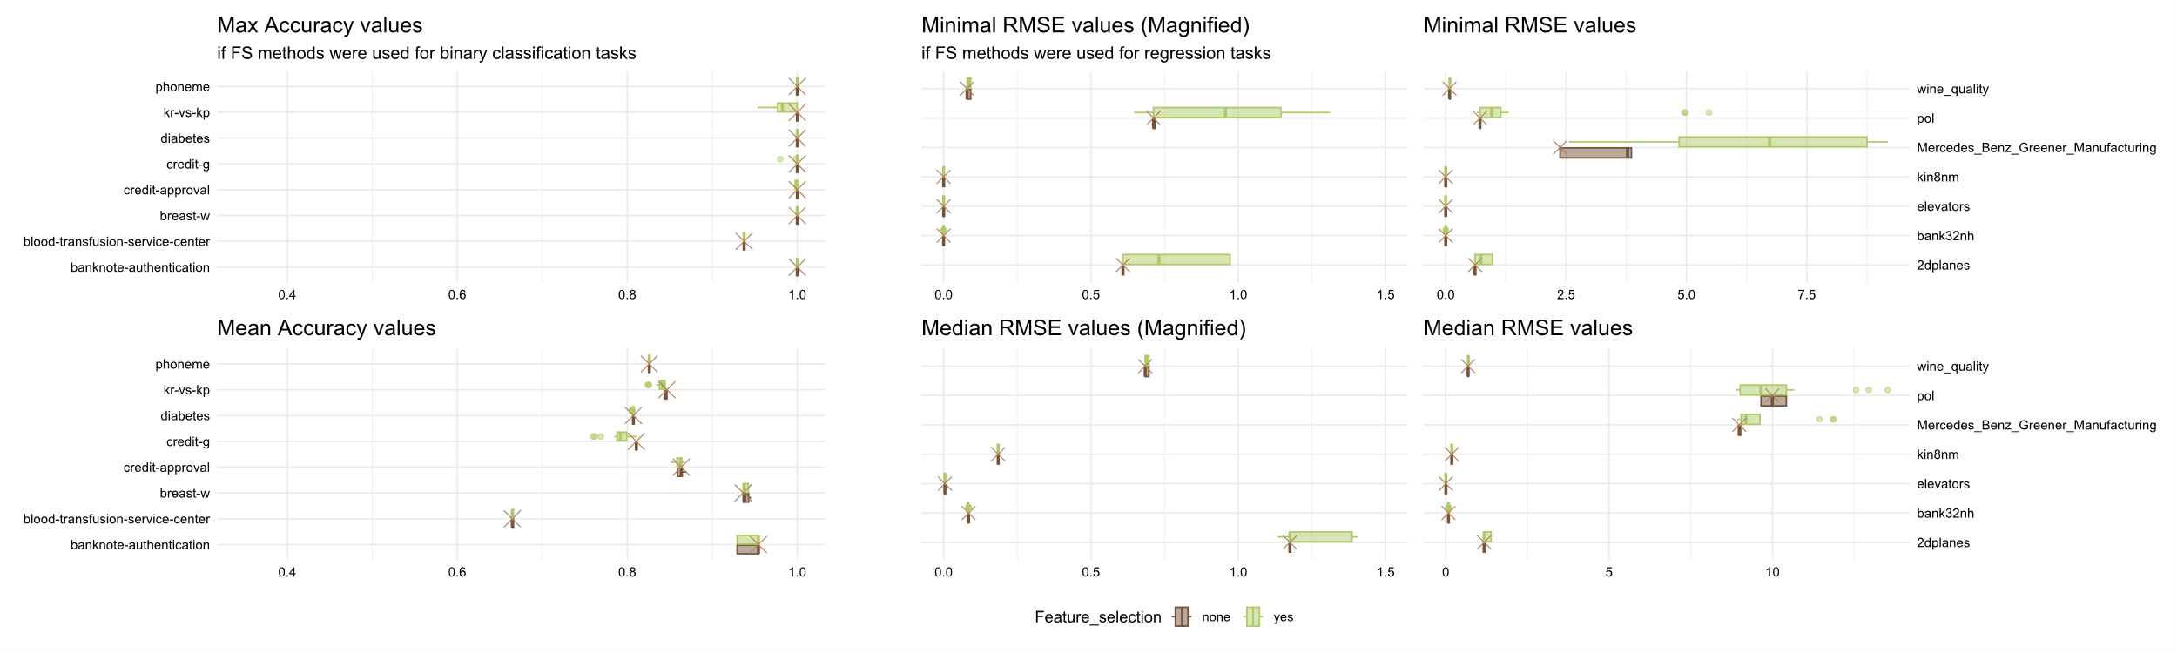
FS impact on performance
Notes:
Similarly to the duration, the performance mostly depends on the fact that any feature selection method is used in the preprocessing stage. The visualizations on this slide can lead us to the same conclusions as the ones derived from the previous ones.
Moreover, we can clearly see that the improvement in the case of breast-w, and pol datasets originates in proper feature selection strategy. In other cases, however, obtained results did not improve, or were even worse than the baseline.

Slide 29
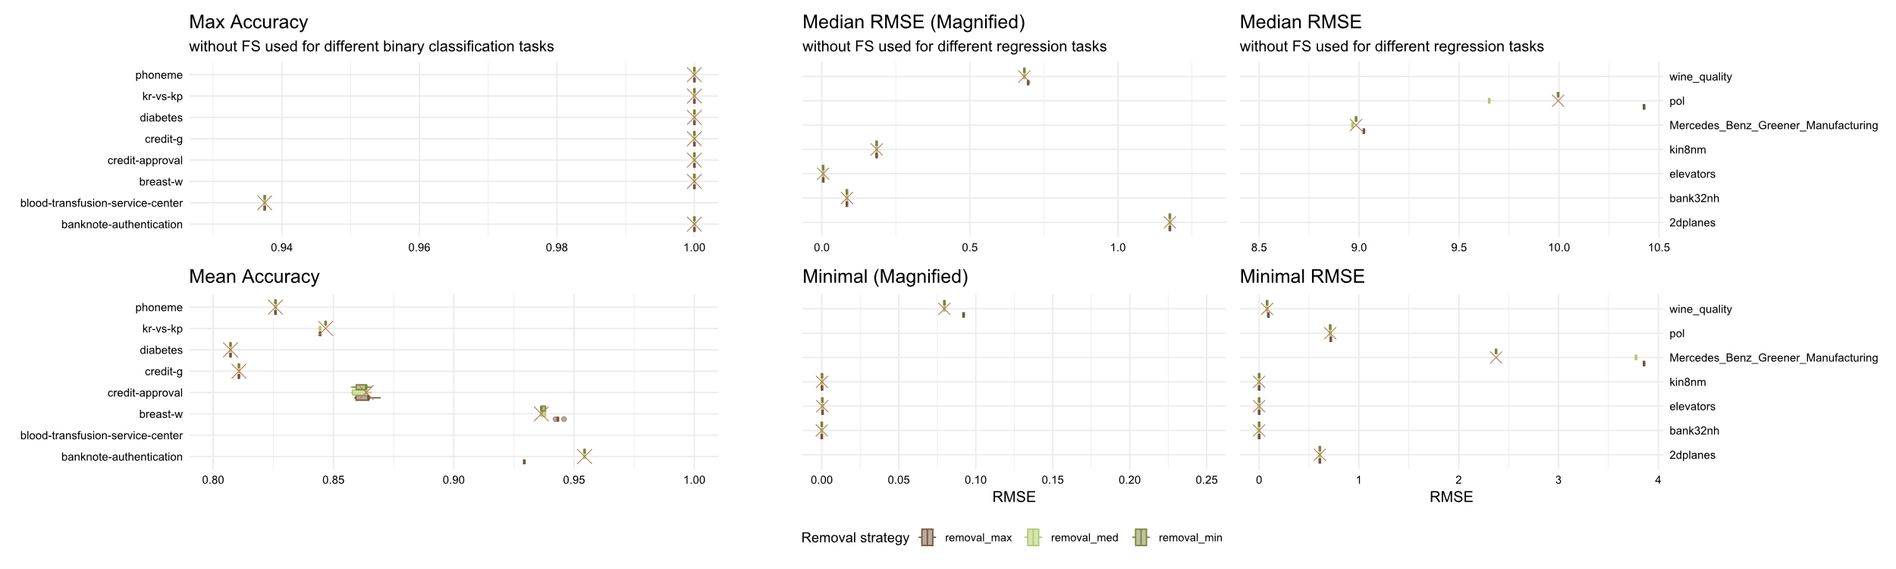
Removal impact on performance
Notes:
From the next plot, even at first glance, we can notice that the results are more stable than when feature selection methods were used. Quite interestingly, different removal strategies also tend to obtain similar results, although there are some exceptions.
For both binary classification and regression tasks, we can witness that some datasets benefit from more advanced removal settings (credit-approval, breast-w, pol), whereas others suffer because of it (kr-vs-kp, banknote-authentication, phoneme, Mercedes_Benz_Greener_Manufacturing).
In general, however, those results do not change the outcomes drastically, but combined with the relatively low increase of computational time, they can be used to slightly enhance models’ performance. The process of choosing the optimal setting for the step should be executed carefully, as there is no heuristic approach that visibly better results.

Slide 30
Conclusions
1. Trees are extremely efficient baseline models, which only use basic preprocessing.
2. Well-suited removal strategies are safe to use.
3. Their benefits are short time, and dimensionality reduction.
4. In general, longer preprocessing leads to shorter training,
5. Feature selection methods are unstable in the case of both time complexity and final results.
6. Feature selection is the most time-consuming part of preprocessing.
7. Feature selection algorithms tend to worsen the performance, rarely improving it.
Notes:
So, let’s finally jump to the conclusions, that can be derived from current state of my study:
1. Trees, provide extremely efficient baseline models, which only use the most basic preprocessing strategies. However, in some cases of hard tasks, those results can be improved,
2. Well-suited removal strategies can improve models’ performance slightly, but in most cases, they did not affect the results, thus they are safe to use without extensive study,
3. Additionally they last for a short time, and feature removal leads to dimensionality reduction, which accelerates the training time,
4. In general longer preprocessing leads to shorter training which levels off full-time,
5. Feature selection methods are the most unstable part of the pipeline in the case of both time complexity and final results,
6. They are the most time-consuming part of preprocessing, although there are fast methods like MI, and BORUTA, and slow ones: MCFS, and VI,
7. Feature selection algorithms tend to worsen the performance, but in rare cases might lead to enhancing the outcomes.

Slide 31
Thank you for attention!
Notes:
So, thank you for your attention. I hope you enjoyed this presentation, and I'm open to some discussion and questions regarding our topic.

Slide 32
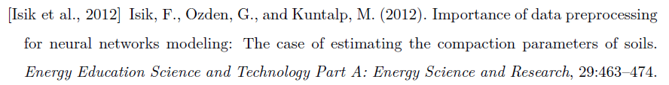
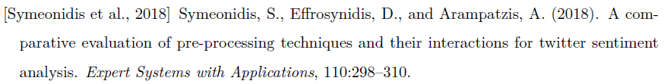
Literature

Slide 33
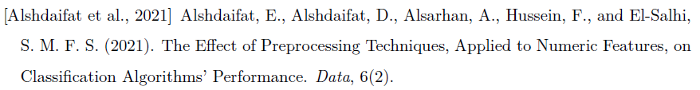
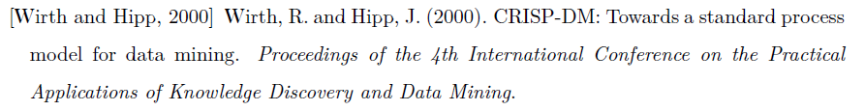
Literature

Slide 34
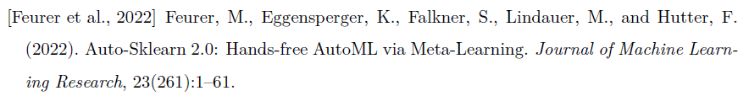
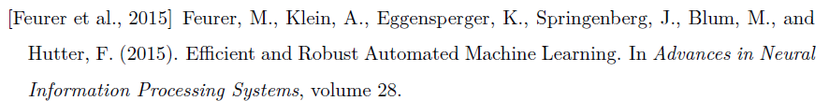
Literature

Slide 35
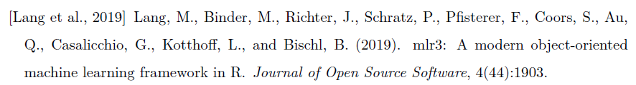
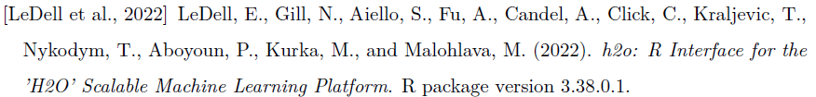
Literature

